Slide 1
Team 2 : RideEase ER Diagrams

Slide 2
Team 2 : RideEase List of Entities
Entity Name | Entity Primary Attributes
Users | UserID, UserName, Email, PhoneNumber, Address, Password, UserType
Vehicles | VehicleID, UserId , Model, Type, Color, LicenseNo, VIN
Bookings | BookingID, UserID, DriverID, PickupLocation, DropOffLocation, TotalFare, BookingStatus, PickupDate
Payment | PaymentID, BookingID, UserID, Amount, PaymentMethod, PaymentStatus
Driver | DriverID, UserId, Name, VehicleID
Rating | RatingID, UserID, VehicleID, Rating, ReviewComment, DateSubmitted
SupportTickets | TicketID, UserID, IssueCategory, Description, Status, CreatedDate
PromoCode | PromoID, Code, Discount, ExpiryDate, EligibilityCriteria
Notifications | NotificationID, UserID, PromotionId, ReferralId, TimeStamp
Referral | ReferralID, UserID, ReferralCode, ReferralDate, BonusAmount, ReferralChannel, Notes
PromotionEvent | PromotionID, Description, DiscountValue
RideCommunication | MessageID, BookingID, UserId, DriverId, MessageText, SentAt

Slide 3
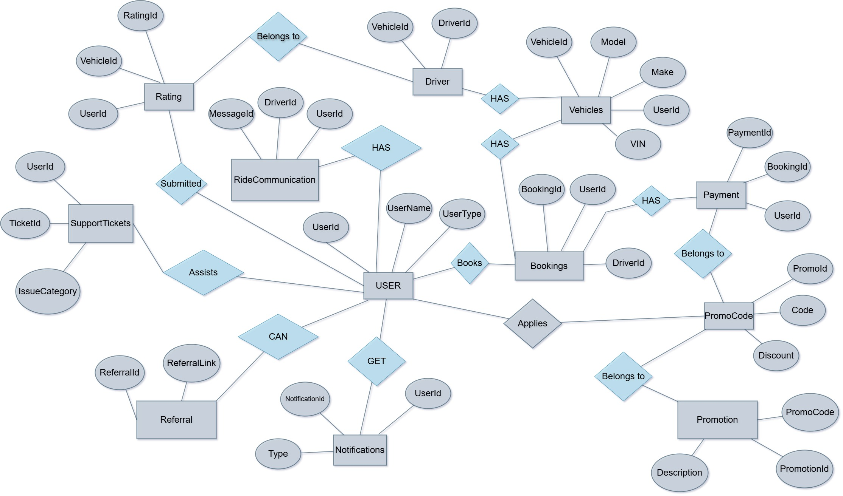
Team 2 : RideEase Conceptual ER Diagram

Slide 4
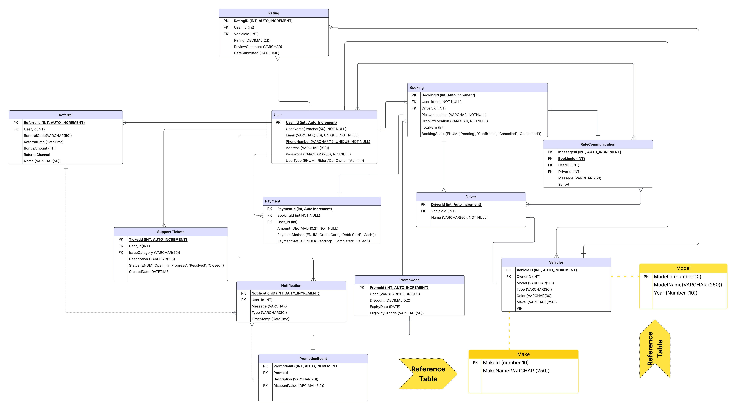
Team 2 : RideEase Logical ER Diagram

